Slide 1
EMPLOYEE ATTRITION
A ‘Case’ Study
Tazeb Abera
December/2019

Slide 2
Introduction
Attrition in human resource is the gradual loss of employee over time.
Case of Attrition may be:
Changes in management style,
company structure,
company might cause employees to leave the company voluntarily,
when a company eliminates a job completely..
Objective
This Case study try address issues concerning the attrition of an employee with respect to several parameters.

Slide 3
Data Quality Check
Data summary
Name | dataset
Number of rows | 870
Number of columns | 36
Column type frequency:
factor | 9
numeric | 27
Data Cleaning
Columns with no variability are dropped.
Drop Over18 as there is no variability, all are Y.
Drop EmployeeCount as there is no variability, all are 1.
Drop StandardHours as there is no variability, all are 80.
Missing variables are also assessed

Slide 4
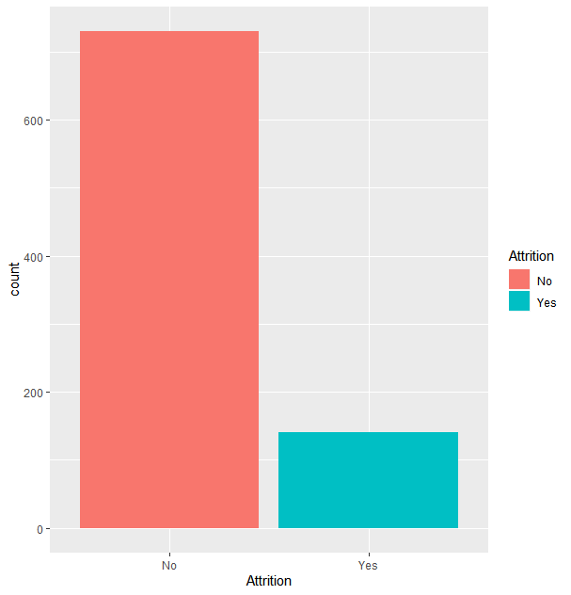
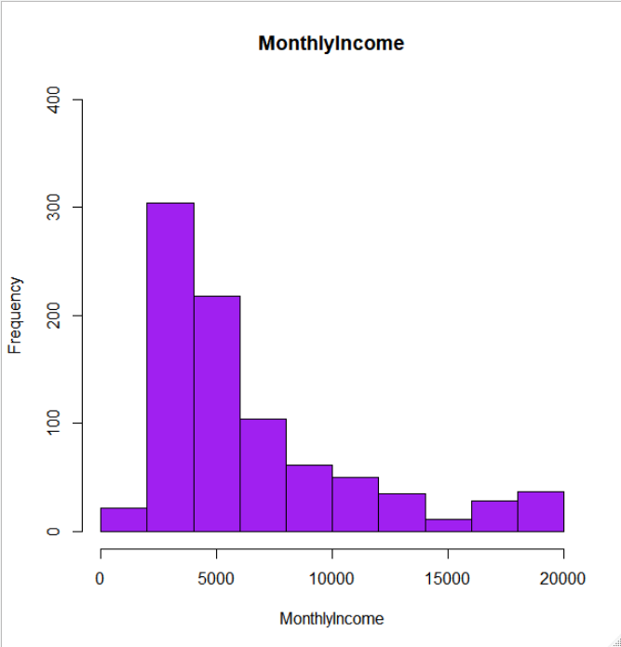
EDA and Data preparation
84%
16%

Slide 5
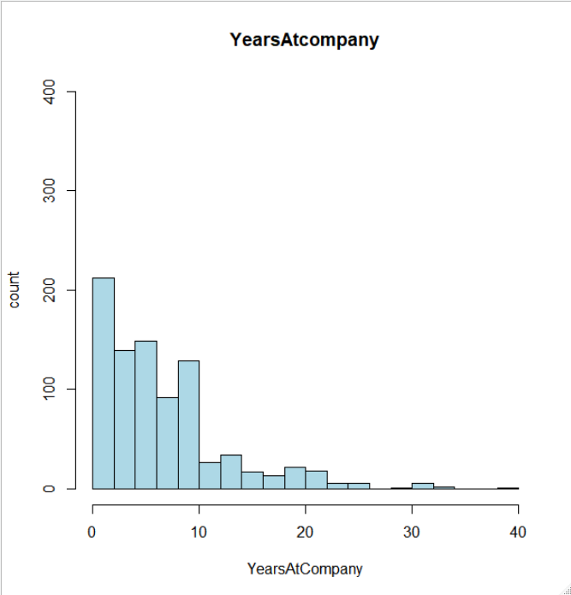
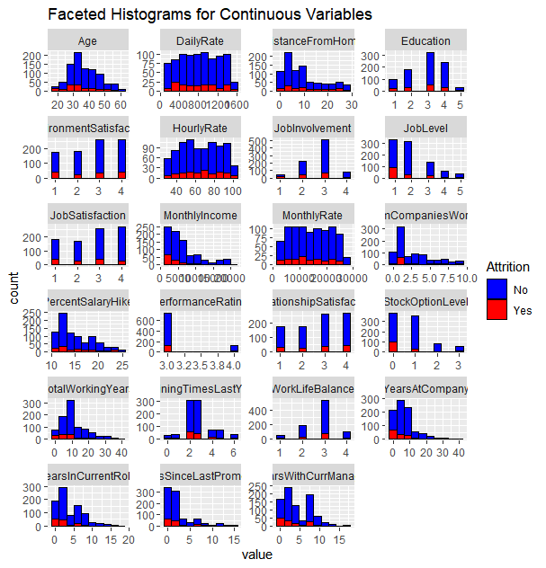
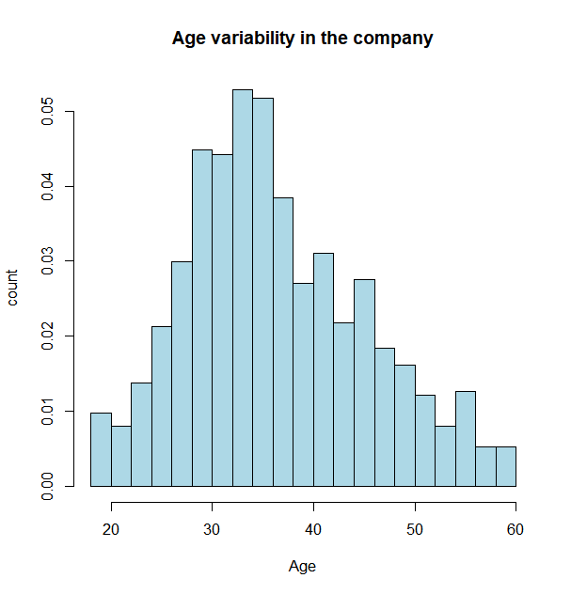
Cont’

Slide 6
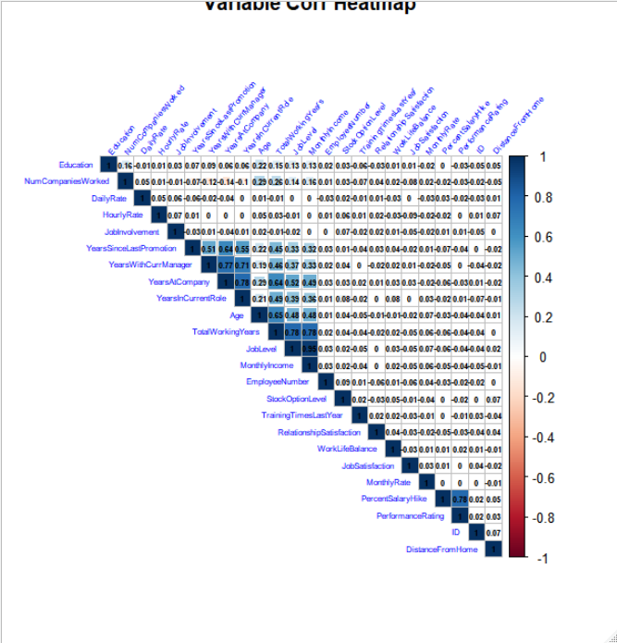
Correlation Matrix
MonthlyIncome vs. JobLevel = 95.16%
TotalWorkingYears vs. JobLevel =78.08%
MonthlyIncome vs. TotalWorkingYears = 77.85%
YearsAtCompany vs. YearsInCurrentRole =77.61%
YearsAtCompany vs. YearsWithCurrManager = 76.52%
YearsWithCurrManager vs. YearsInCurrentRole= 70.95%

Slide 7
Build Model/Results
Supervised machine learning mechanisms techniques used with LASSO variable selection and make a model
Classification prediction model and
Regression
Logistic regression
Random forest are implemented in this project

Slide 8
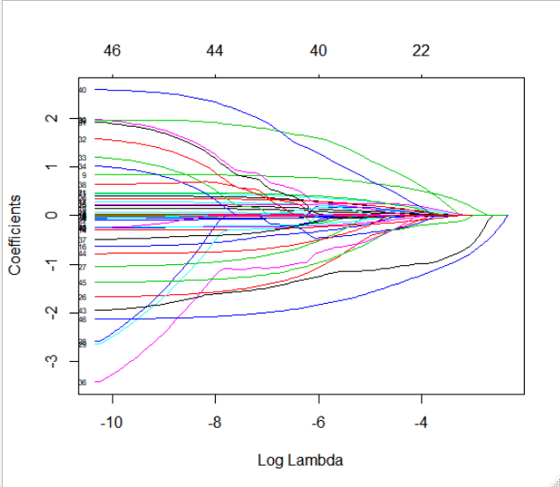

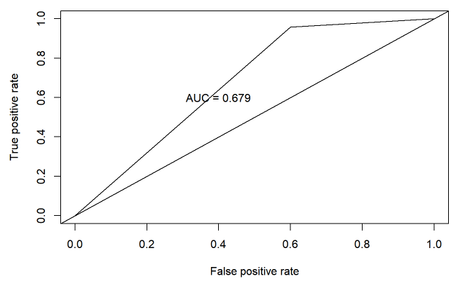
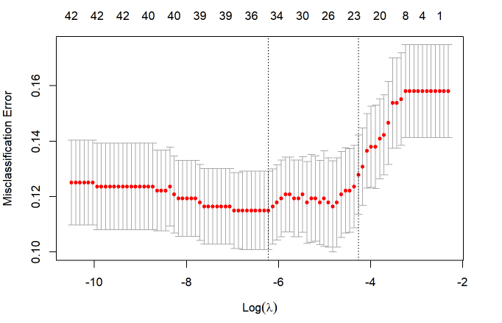
Logistic Regression
With Full Model
With reduced model
Age
BusinessTravel
DistanceFromHome
EnvironmentSatisfaction
JobInvolvement
JobRole
JobSatisfaction
MaritalStatus
NumCompaniesWorked
OverTime
RelationshipSatisfaction
TotalWorkingYears
TrainingTimesLastYear
WorkLifeBalance
YearsInCurrentRole
YearsSinceLastPromotion
YearsWithCurrManager

Slide 9
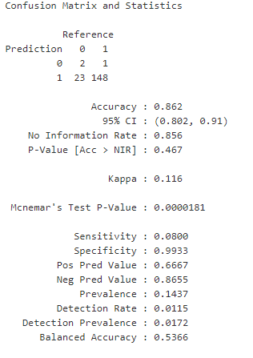
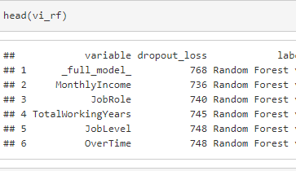
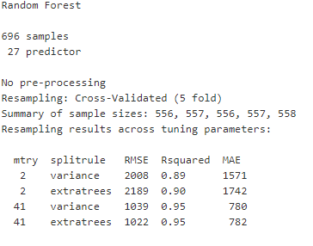
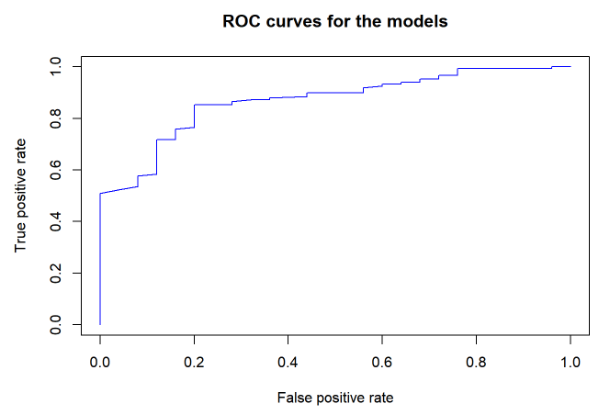

Random forest
KNN
Accuracy was used to select the optimal model using the largest value.
The final value used for the model was k = 17.
Accuracy ~ 85%

Slide 10
Conclusion
The unique contribution of this paper is that we investigated the attributes which majorly contribute in the attrition.
We found that parameters such as Overtime, Gender, Previous Work Experience, Environmental Satisfaction are some of the parameters, which show strong association with attrition, positively or negatively.

